Slide 1
Clean Energy Corps

Slide 2
Agenda
This Moment and Our Goals
What is the Clean Energy Corps
Who we’re looking for
Next Steps

Slide 3
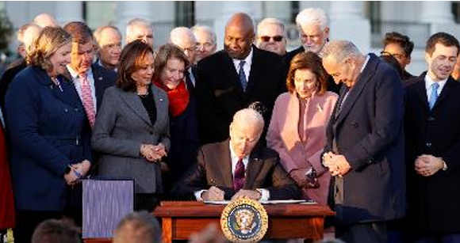

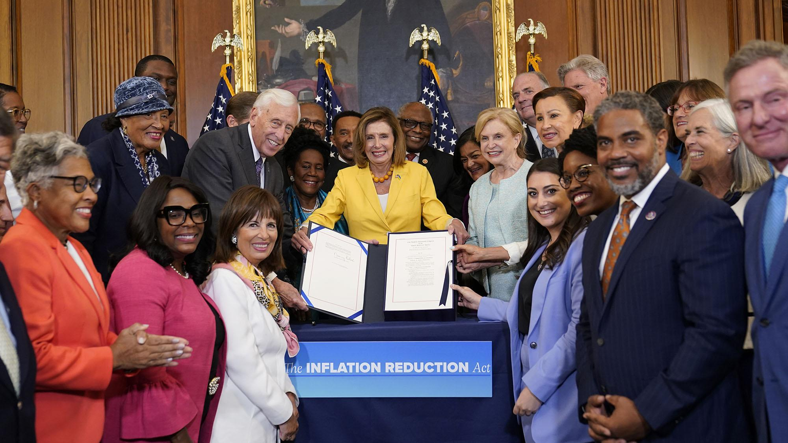
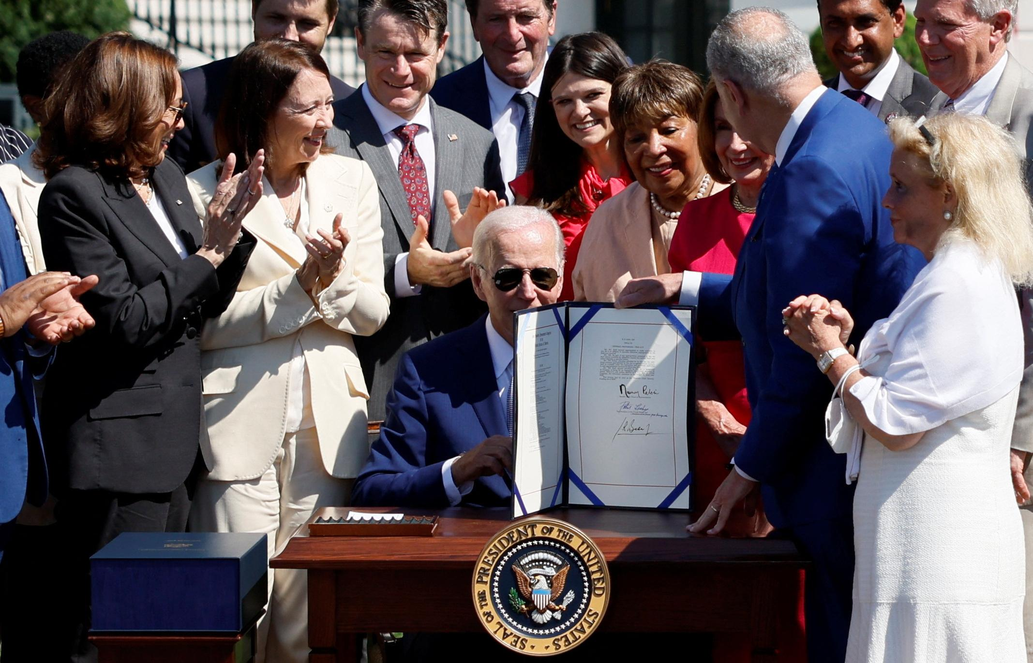
This moment: Generational Investments in Clean Energy
$62 Billion in Bipartisan Infrastructure Law funding to DOE, part of $370B in IIJA funding overall
140 covered programs through the J40 Initiative
$30+ Billion in Inflation Reduction Act funding to DOE, more through tax credits, part of $390B in climate spending
CHIPS Act to invest in domestic manufacturing, science, and R&D capability

Slide 4
Bipartisan Infrastructure Law and Infrastructure Reduction Act Goals
Lowering Energy Bills for Households and Businesses
Creating Good Jobs and Boosting Domestic Manufacturing
Embarking on World-Class, Next Generation Energy Technology Demonstrations
Accelerating Deployment of Secure, Reliable, Clean Energy
Driving just and equitable investments in disadvantaged communities

Slide 5
DOE has already announced $12B+ in funding
$3.1B to lower utility bills through energy efficiency home upgrades for
millions of Americans through DOE’s Weatherization Assistance Program
$3.1B to boost American battery manufacturing and supply chains
$2.4B to support commercial scale demonstrations of advanced
nuclear reactors
$2.6B to support carbon capture demonstration projects
$1.2B to prevent at-risk, carbon-free nuclear facilities from premature closure
$11.2M to support states design State Energy Security Plans
$80M to invest in solar manufacturing, workforce, and technology development

Slide 6
We still have A LOT of work to do
And we need hundreds more staff to do it

Slide 7

DOE’s Clean Energy Corps

Slide 8
The Clean Energy Corps are the critical staff researching, developing, demonstrating, and deploying DOE’s clean energy solutions.
We are hiring the staff necessary to implement the Bipartisan Infrastructure Law (and Inflation Reduction Act!)

Slide 9
Clean Energy Corps Basics
Hires will support DOE’s Clean Energy Research, Development, Demonstration, and Deployment Mission
Most hires for Offices in DOE’s Under Secretary for Infrastructure
Hires at all levels—with current focus on mid career (7+ years) and Senior (15+ years)
Hires utilize Direct Hire Authority – allows hires to move faster and more easily than traditional career hire pathway
Career hires with mix of permanent and term positions, flexible hybrid or remote opportunities

Slide 10
Clean Energy Corps Vision
DOE needs a team of people ready to capitalize on this once-in-a-generation moment
Opportunity to infuse government with a diverse, talented, and driven workforce
Leveraging opportunities to bring in new public servants—using quick hiring and a DEIA-informed interview/selection process
Infuse DOE with the best lessons from the public and private sectors

Slide 11
Primary Hiring Offices
Office of the Under Secretary for Infrastructure
Office of Clean Energy Demonstrations
Office of Manufacturing and Energy Supply Chains
Office of State and Community Energy Programs
Grid Deployment Office
Loan Programs Office
DOE/DOT EV Joint Office
Office of Fossil Energy and Carbon Management
Office of Energy Efficiency and Renewable Energy
DOE Field Sites and Service Centers

Slide 12
Key Hires
Project Officers – the day-to-day technology-focused project managers who will ensure that the billions of dollars invested in local governments and private sector are on time, on task, and on budget
Stakeholder Engagement – Staff focused on engaging critical communities necessary to do this work. Will work with businesses, community groups, trade associations, and more to inform the success of our projects and inform communities of this work
Workforce Development – Program staff helping ensure we have the workforce necessary to do these clean energy jobs at scale
Program Managers – Skilled people leaders who have proven clean energy demonstration and deployment experience

Slide 13






Key Hires -- Leadership
Civil Nuclear Credit Program Manager
  $6B program to keep existing reactors online
  Work with states, utilities, nuclear and hydro industries
Industrial Assessment Center Program Manager
  Manage program to improve energy efficiency in heavy industry
Weatherization Program Manager
  Help manage additional$3.5B in Weatherization funding in a $6B program
Director of External Affairs
  Build and drive an external affairs strategy across all Under Secretary for Infrastructure Offices
  Manage communications, stakeholder, leg staff
Director of Renewable Energy Programs
  Manage vertical covering Clean Energy demonstrations in rural areas, on mine lands, and through energy storage
Critical Materials Program Manager
  Oversees $6.2B battery and critical mineral recycling programs, as well as rare earth demonstration facility programs

Slide 14
Next Steps
We want to work with YOU to target opportunities to your networks
Reach out to key candidates directly
Encourage people to submit their resume to: Energy.gov/CleanEnergyCorps

